Slide 1
AI-Scored Shortlist – AI Powered HR Shortlisting Agent
Automating Resume Screening with Llama 3.3 and Groq
Presenter:-
Saumya Ranga

Slide 2
Introduction
An intelligent recruitment agent that reads a Job Description, evaluates candidate resumes across a dynamic 5-dimension rubric powered by Groq (Llama 3.3 70B), and produces a ranked, explainable shortlist with Human-in-the-Loop override support.
Live Demo: https://ai-scored-shortlist-dsvis2xrnboa6kfuxzhczg.streamlit.app/ GitHub: https://github.com/saumyaranga29/AI-scored-Shortlist
Sample Report:-https://drive.google.com/file/d/1t4dTcrkjkHdgLx5iWUj5tXPs67gLE6yL/view?usp=sharing

Slide 3
The Problem
Time-Consuming: HR professionals spend countless hours manually reviewing hundreds of resumes.
Inconsistent Evaluation: Human bias and fatigue lead to inconsistent candidate scoring.
Poor Candidate Experience: Slow review processes cause companies to lose top talent to faster competitors.
The Need: A system that can accurately, fairly, and instantly parse and rank candidates based on a specific Job Description.

Slide 4
The Solution- AI Driven Recruitment Intelligence
Automated Parsing: Extracts key skills, experience, and education from any Job Description and unstructured Resumes (PDF, DOCX, TXT).
Dynamic 5-Dimension Rubric: Automatically evaluates candidates on 5 key dimensions tailored specifically to the uploaded JD.
Lightning Fast Inference: Powered by Groq's LPU and Llama 3.3 70B, scoring happens in seconds, not hours.
Actionable Output: Generates a ranked shortlist with transparent justifications and exportable HTML/JSON reports.

Slide 5
Project Overview
Manual resume screening is slow, inconsistent, and prone to bias. This agent automates the initial shortlisting step end-to-end:
Parses the Job Description → extracts required skills, experience, education, and role context
Generates a dynamic 5-dimension rubric → tailored to the specific JD, not generic
Parses each resume → PDF, DOCX, or TXT supported
Scores every candidate using Llama 3.3 70B via Groq's high-speed inference
Ranks candidates and provides explainable scores with strengths, gaps, and a hiring recommendation
Human-in-the-Loop override → HR professionals can review AI reasoning and adjust scores; all changes are audit-logged
Exports a rich HTML report or raw JSON

Slide 6
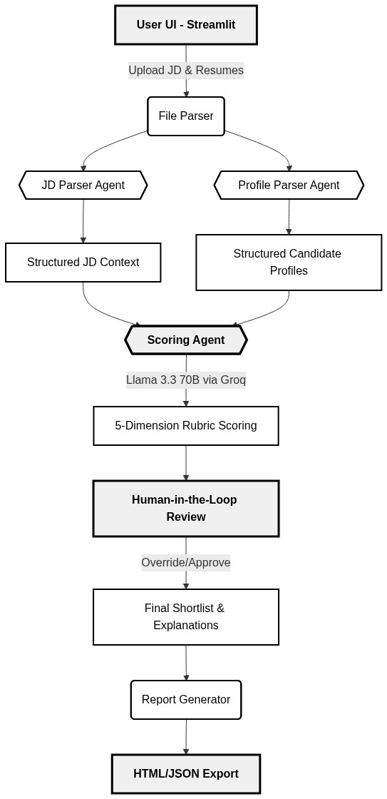
System Architecture
1. Ingestion: User uploads a JD and a batch of resumes via the Streamlit UI.
2. Parsing Agents: The JD and Resumes are parsed into structured JSON schemas using Pydantic.
3. Scoring Agent: Llama 3.3 70B compares the structured profiles against the JD.
4. Human-in-the-Loop: HR reviews the AI's justifications and finalizes the scores.
5. Export: The system generates the final Shortlist Report.

Slide 7
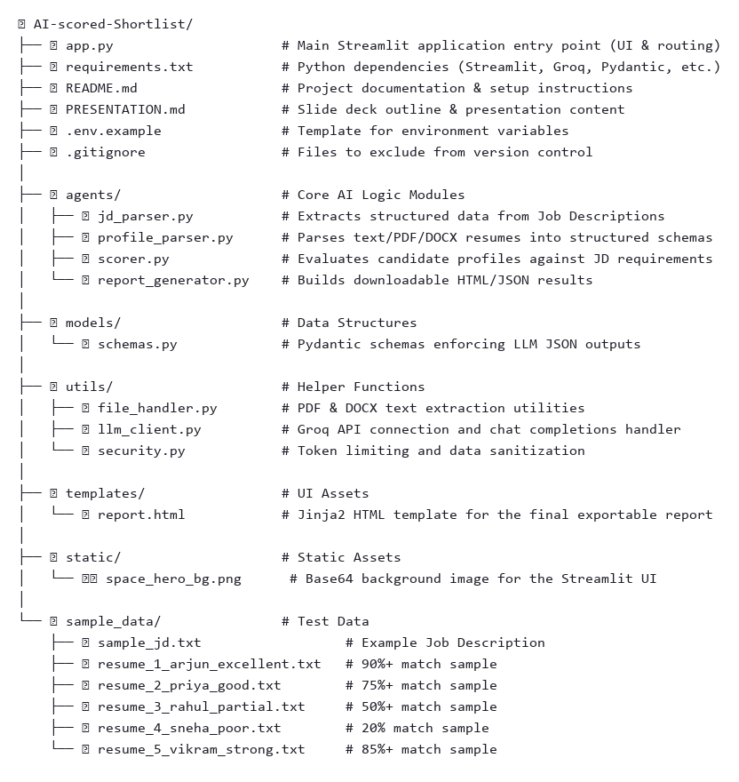
Repo Structure

Slide 8
Key Components
File | Role
app.py | Streamlit UI, orchestrates the full pipeline
agents/jd_parser.py | Extracts structured data from Job Description
agents/profile_parser.py | Parses resume text into structured candidate profile
agents/scorer.py | Scores candidates using dynamic rubric via LLM
agents/report_generator.py | Generates HTML & JSON export reports
utils/llm_client.py | Groq API wrapper, handles structured output
utils/file_handler.py | Reads PDF, DOCX, TXT resume files
models/ | Pydantic models for JD, candidate profile, scores
sample_data/ | Sample JD + 5 resumes (strong → no match)

Slide 9
Tech Stack
Category | Technology | Purpose / Rationale
Core Language | Python 3 | Main programming language used for scripting and data processing.
Frontend UI | Streamlit | Rapid prototyping of the web application and interactive Human-in-the-Loop review dashboard.
Large Language Model | Llama 3.3 70B | Core intelligence engine providing high-reasoning capabilities for complex, subjective candidate evaluation.
Inference Engine | Groq LPU | Delivers lightning-fast token generation to process multiple resumes rapidly without timeout errors.
Data Structuring | Pydantic | Enforces strict JSON schemas for LLM outputs, acting as a guardrail against hallucinations and parsing errors.
Environment/Secrets | python-dotenv | Securely loads API keys locally, alongside Streamlit Cloud's native Secrets manager for production.
Reporting/Export | Jinja2 | Templates and dynamically generates the visually rich, downloadable HTML Candidate Shortlist Reports.
Version Control | Git & GitHub | Source code tracking and remote repository hosting.
Deployment | Streamlit Community Cloud | Free, seamless cloud hosting linked directly to the GitHub repository.

Slide 10
Security Mitigation
Risk | Mitigation
API key exposure | Keys stored in .env file (local) or Streamlit Secrets (cloud). .env is in .gitignore. .env.example provided with placeholder values only ; never real keys
Resume data privacy | No data is persisted to disk or database. All processing is session-scoped in Streamlit's session_state. Files are discarded when the session ends
Prompt injection | Resume content is passed as user data, not as system instructions. LLM prompts clearly delineate between system instructions and user-provided content
File type validation | file_handler.py validates MIME types before processing. Only .pdf, .docx, and .txt are accepted
Override accountability | All score overrides are logged with timestamp, candidate name, new score, and reason. The audit log is visible in the UI and included in JSON exports
Dependency security | requirements.txt pins versions. No unverified third-party packages used

Slide 11
Results and Learnings
Results:
Speed: Reduced initial screening time from days to seconds.
Transparency: Every candidate receives a structured score (out of 10) with explicit, readable justifications for why they matched (or didn't).
Accuracy: Pydantic-enforced JSON outputs resulted in 0% parsing errors during evaluation.
Demo Validated: Successfully tested against a diverse pool of sample resumes (Excellent, Good, Partial, and Poor matches).
Learnings:
Prompt engineering is iterative; enforcing structured output (JSON/Pydantic) from Day 1 saved hours of debugging.
Groq's speed enables batch processing that would otherwise cause timeout errors on traditional APIs.
Future Enhancements:
Email Automation: Add an agent to automatically draft personalized rejection or interview invitation emails.
Caching: Implement LangChain SQLite caching to reduce API calls for duplicate resumes.
Observability: Integrate LangSmith/Langfuse to monitor token usage and trace the LLM's reasoning over time.

Slide 12
Thank You

